Slide 1

CSC 301 Tutorial 1
Joel Cheverie
Daytime Section 3: T 12-1
RW 142

Slide 2
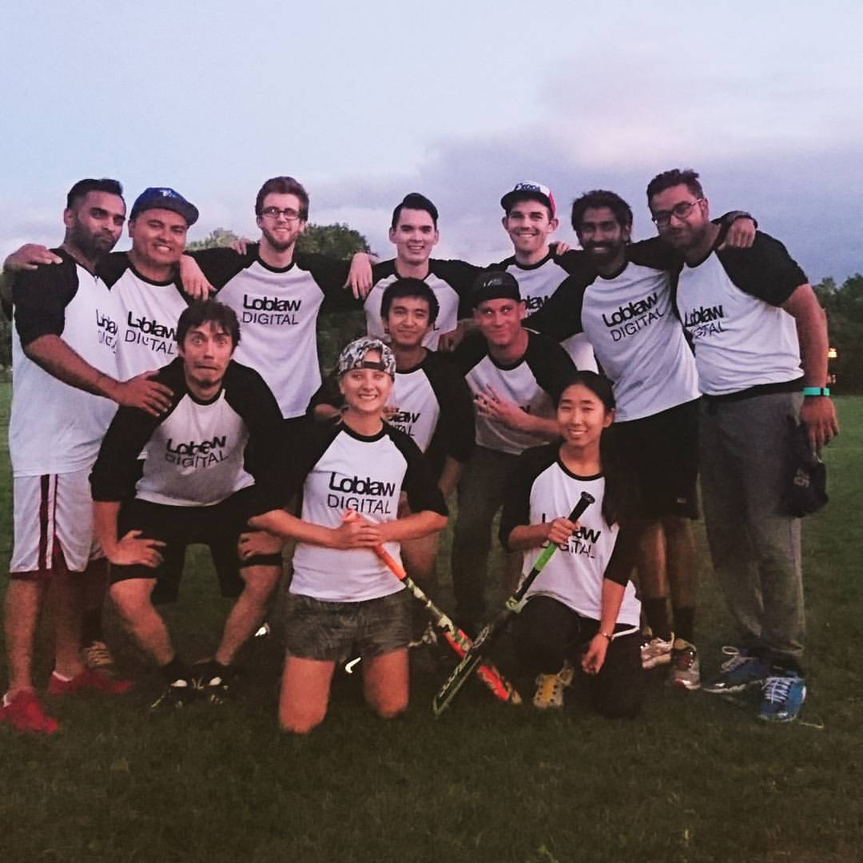
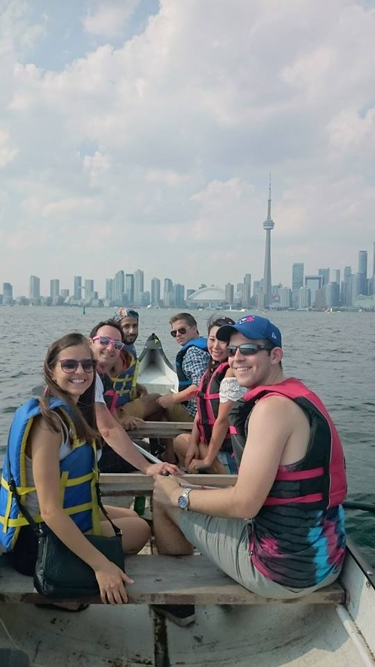
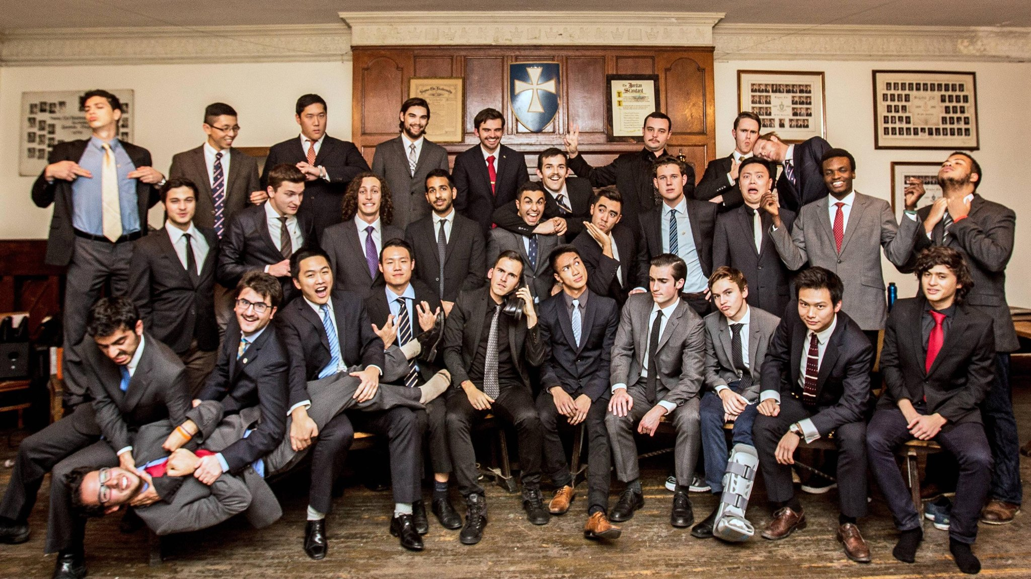
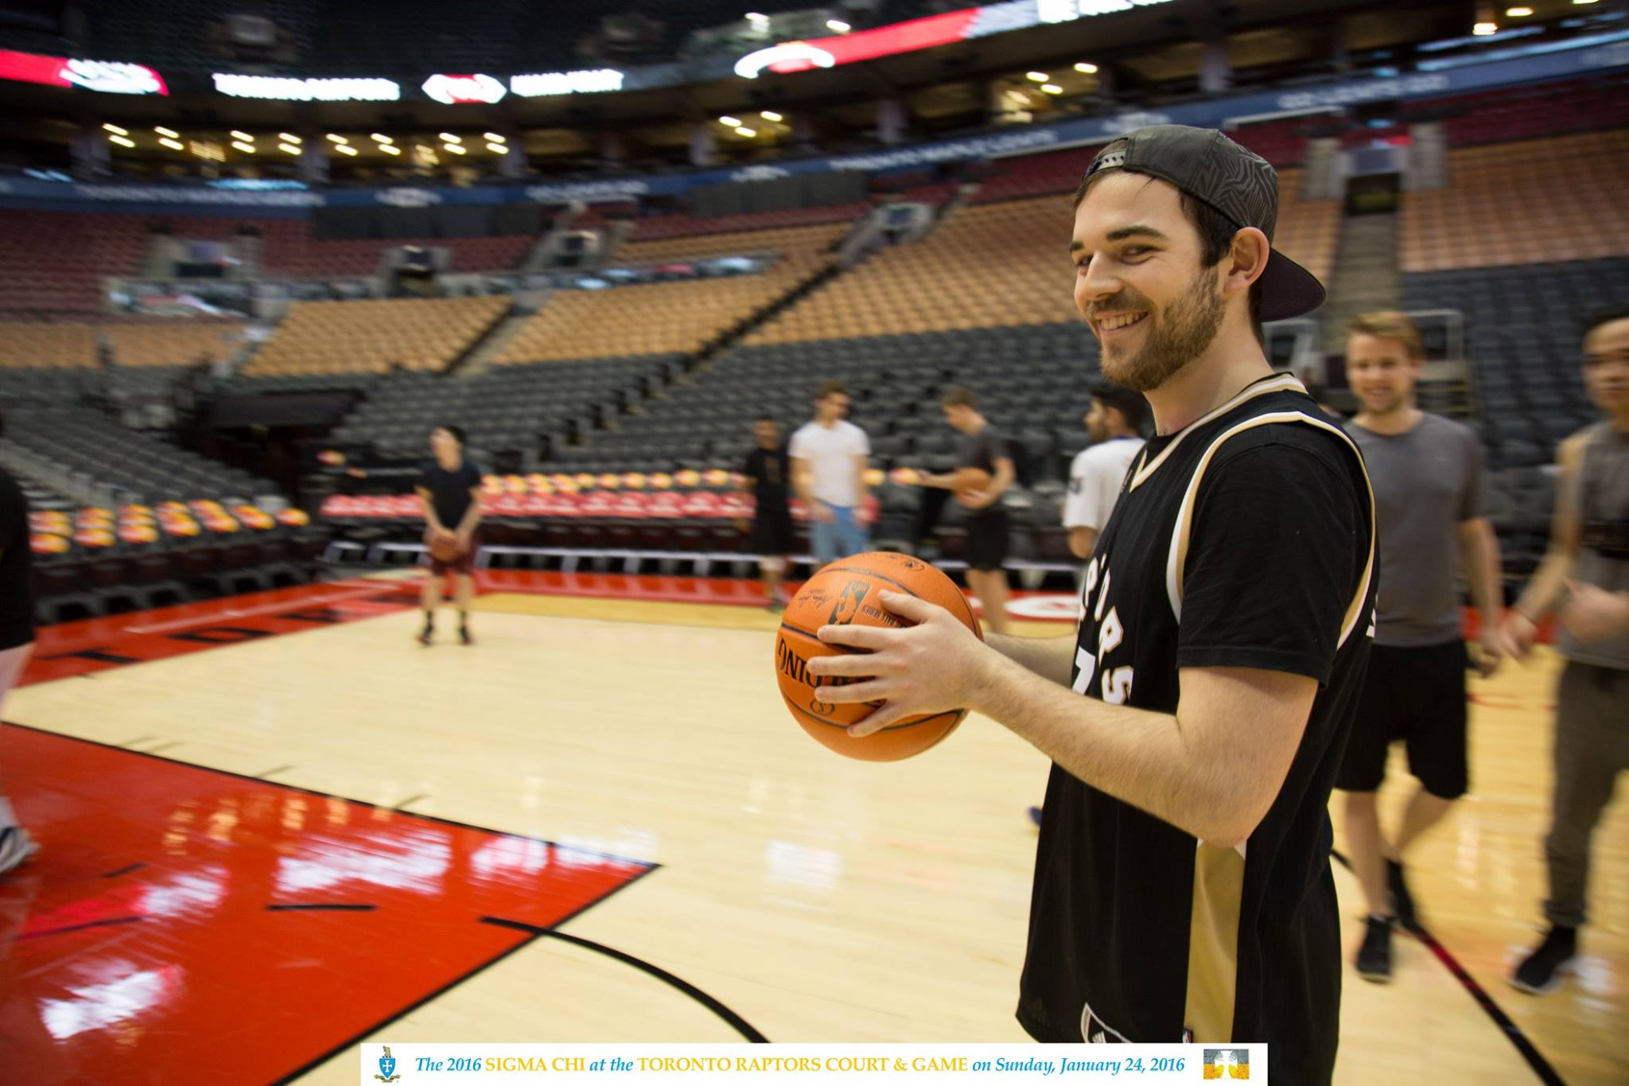
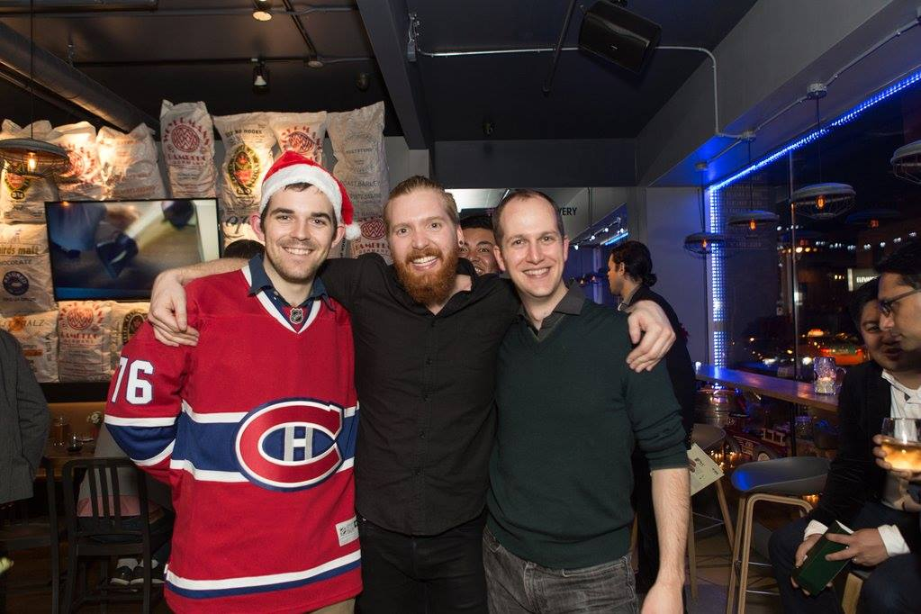
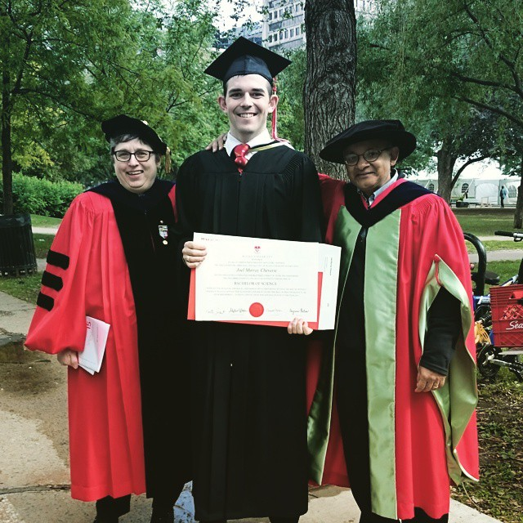
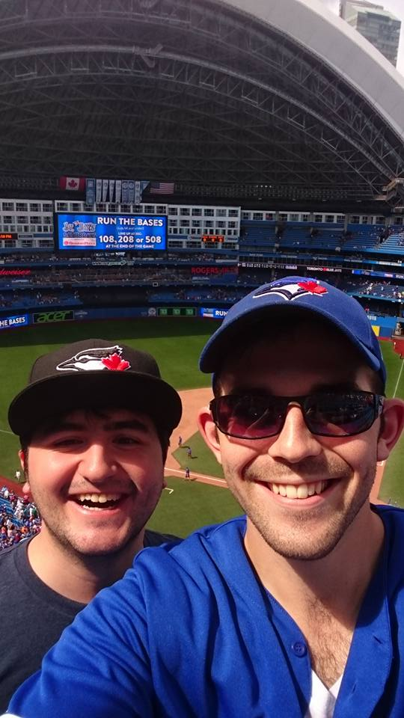
About Me
I’m your mentor this term
MSc Student in Machine Learning
Previously Java Software Developer
BSc in Mathematics & Computer Science from McGill

Slide 3

Contact
Website: http://www.cs.toronto.edu/~joel
Github: @JoelChev
Email: joel.cheverie@mail.mcgill.ca
Office: SF 3203
Office Hours: TBD

Slide 4

Some Administrative Matters
Contact Specifics
Office Hours
Format of Tutorials

Slide 5

Itinerary for Today
Introductions
Pitch/Form Groups

Slide 6

Ice Breakers
To kick things off, let’s get everyone talking.

Slide 7

Partner Up!
Partner up with the person next to you. Please discuss:
What you think of the course so far, what you hope to get out of it, your software background, etc...
We will regroup in a few minutes.

Slide 8

Introduce Yourselves
We will be all be working together this term!
It’s important to attach some names to faces.
Name
Superpower
Favourite Coding Language
Software Experience

Slide 9

Pitches
Does anyone have an idea already?
Who are you looking for? What skills do you need?
Do you plan on working remotely or on campus?
What is your work schedule? Are you hoping to work during the day? Are you a night owl? Are you going to work weekends?

Slide 10
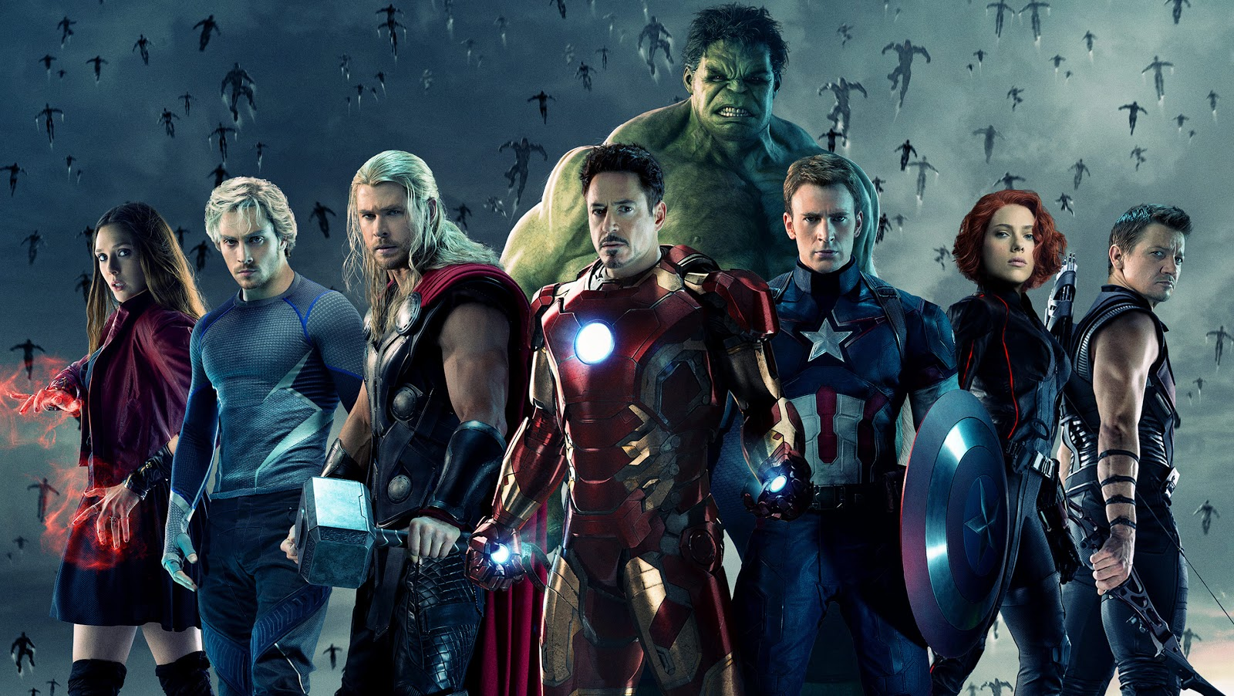
Team Up!
Teams of 5-7 students
Teams have to be finalized by tomorrow
Register here (link is on Discussion Board too)

Slide 11

Next Week
I will present a software project to kick things off
We will establish a group presentation schedule

Slide 12

Have a Good Week!
Groups should meet at least once this week and start on the project.
Your first deliverable is due the week of October 24!
Good luck!

